Slide 1
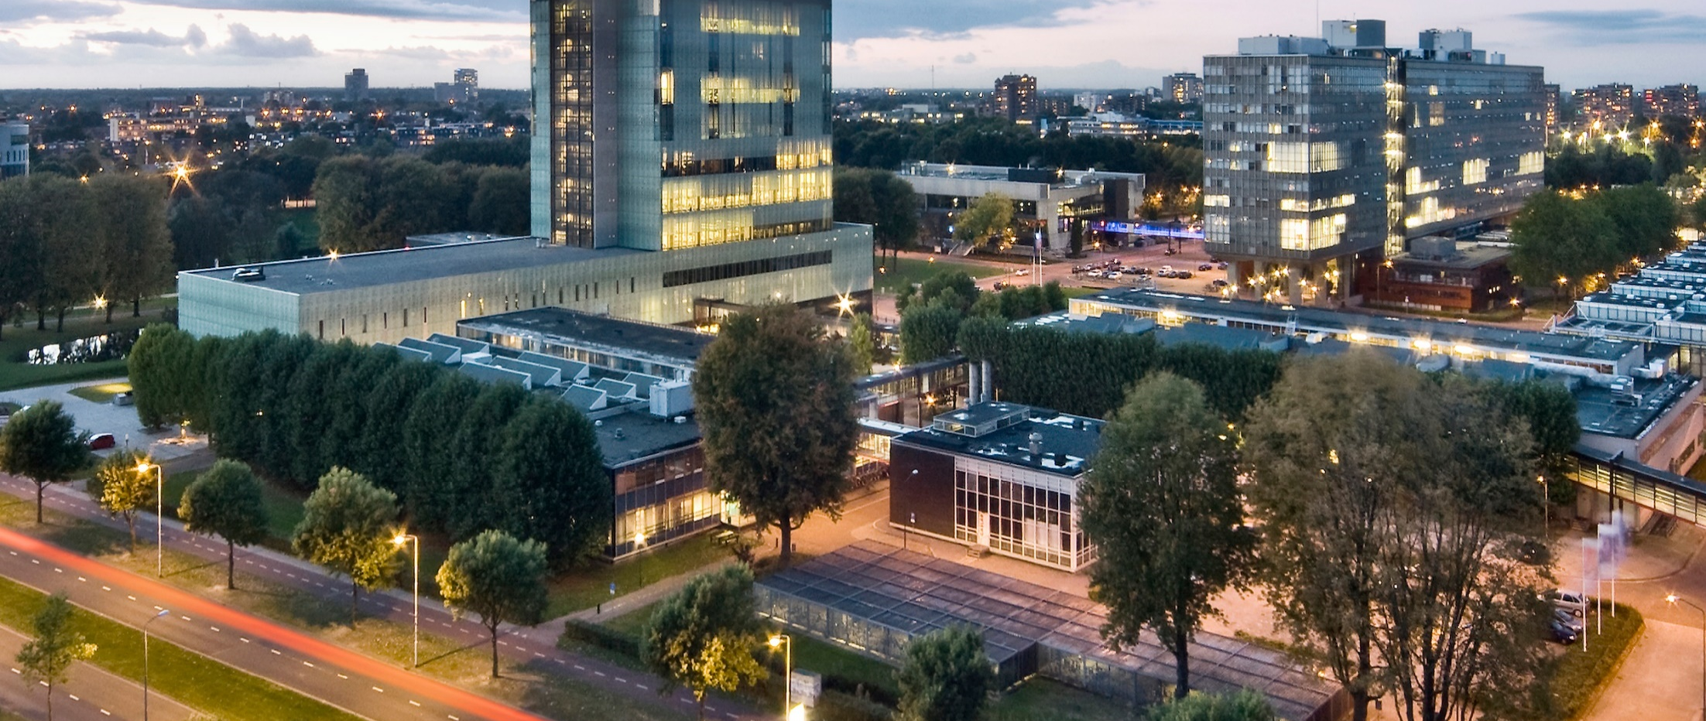
Golden Ratio
DAY2-CLASSIC-CURVES-ELLIPSE
Prof. dr. ir. Loe Feijs
Department of Industrial Design, TU Eindhoven

Slide 2
Resources
Processing3, please install from
https://processing.org/download/
Github, digital-craftmanship’s repository GOLDEN-RATIO
this powerpoint (.pptx)
threadArtEllipse.pde
generateAndTestEllipse.pde
https://github.com/digital-craftsmanship/GOLDEN-RATIO/tree/master/DAY2-CLASSIC-CURVES-ELLIPSE
External link, Wolfram’s MathWorld on ellipse
http://mathworld.wolfram.com/Ellipse.html

Slide 3
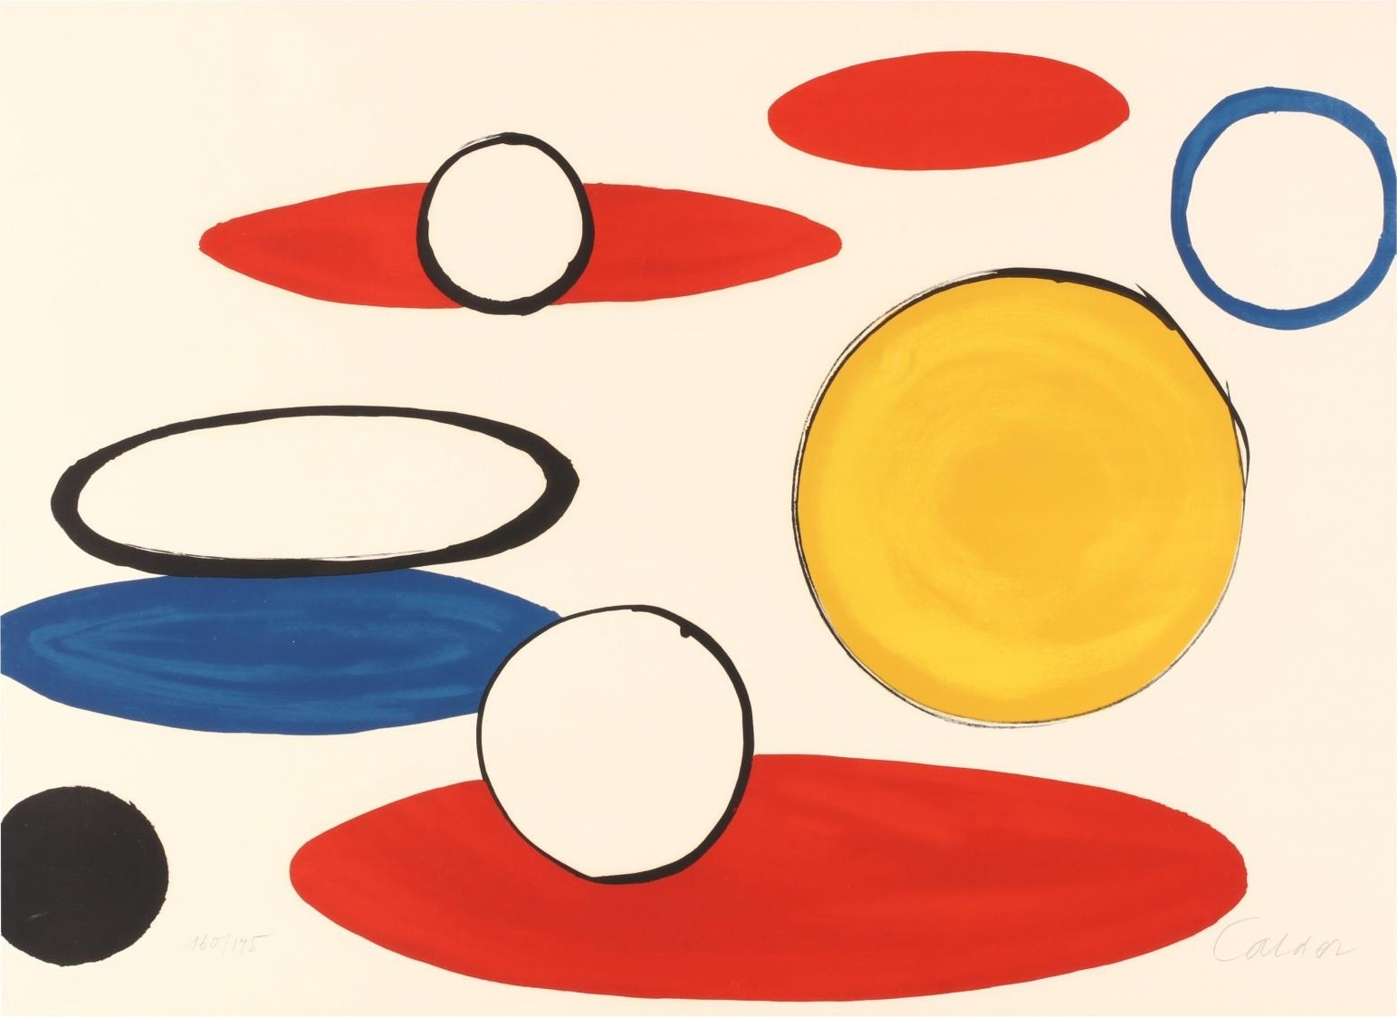

Inspiration
Alexander Calder,
White Circles and Ellipses, from Our Unfinished Revo-lution, 1975 - 1976

Slide 4
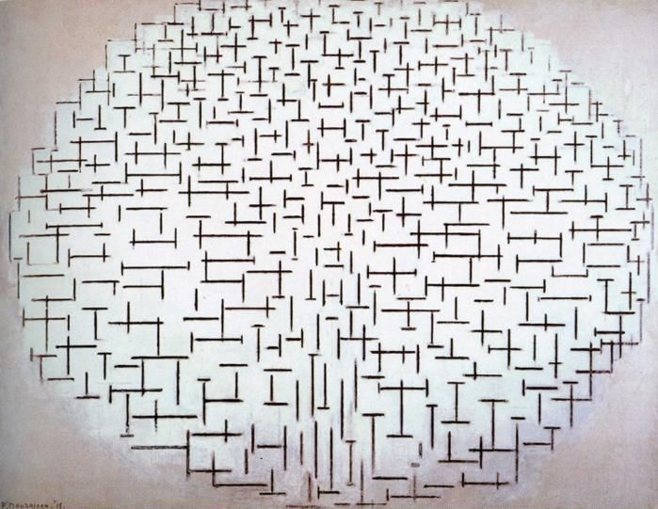
Inspiration
Piet Mondriaan, Composition No. 10 (Pier and Ocean), 1915

Slide 5
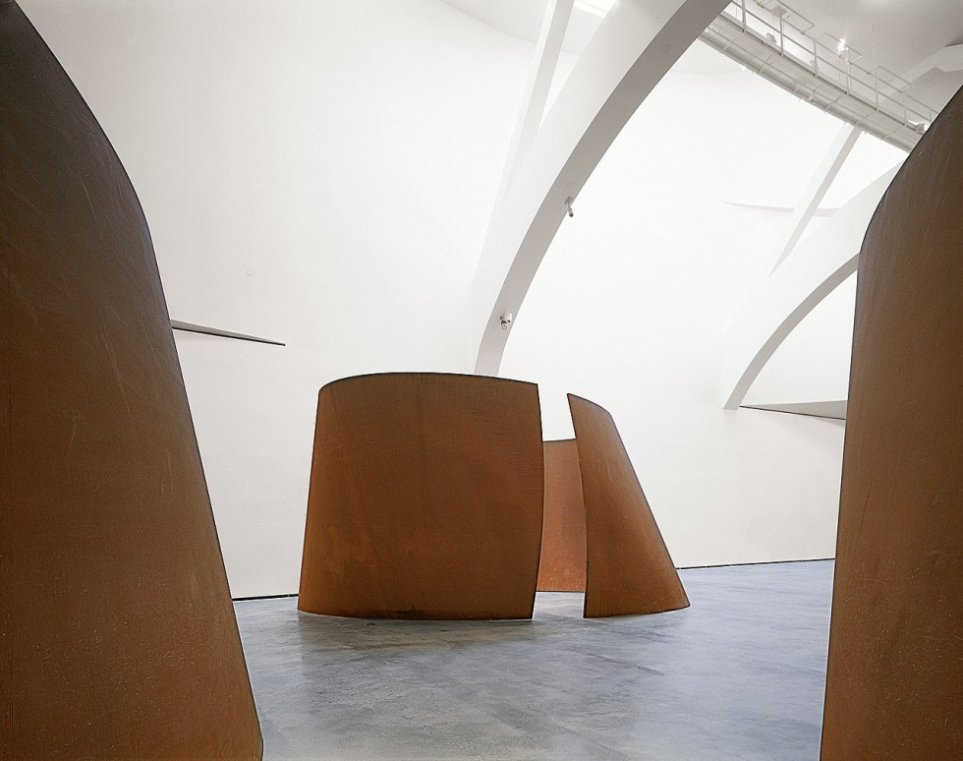
Inspiration
Richard Serra,
Torqued Ellipses, 1996
© Guggenheim Museum

Slide 6
Today’s lecture:
ellipses in nature
mathematics of ellipses
example: generate-and-test
example: thread art design

Slide 7
Ellipses in “nature”

Slide 8
Ellipses in “nature”

Slide 9
Ellipses in “nature”
Oblique view of circles
Orbits of planets and moons
Theatre design with acoustic effects

Slide 10
Ellipses in “nature”
Oblique view of circles
Willem Claesz Heda, detail from a masterpiece painted still life uitsnede uit een meesterwerk stilleven vol geschilderd met ellipsen. ca 1635, Rijksmuseum Amsterdam.

Slide 11
Ellipses in “nature”
Oblique view of circles
Willem Claesz Heda, detail from a masterpiece painted still life uitsnede uit een meesterwerk stilleven vol geschilderd met ellipsen. ca 1635, Rijksmuseum Amsterdam.

Slide 12
Ellipses in “nature”
Oblique view of circles
Willem Claesz Heda, detail from a masterpiece painted still life uitsnede uit een meesterwerk stilleven vol geschilderd met ellipsen. ca 1635, Rijksmuseum Amsterdam.

Slide 13
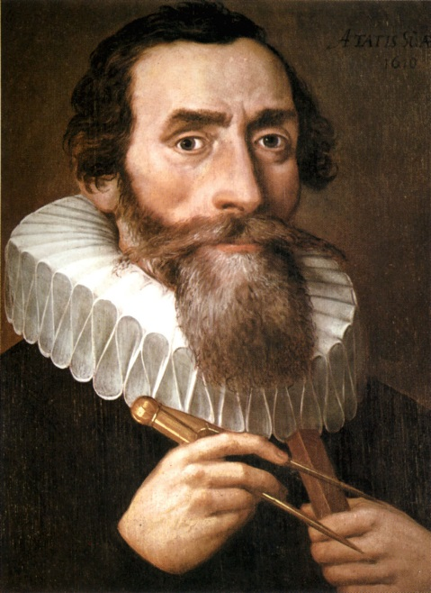
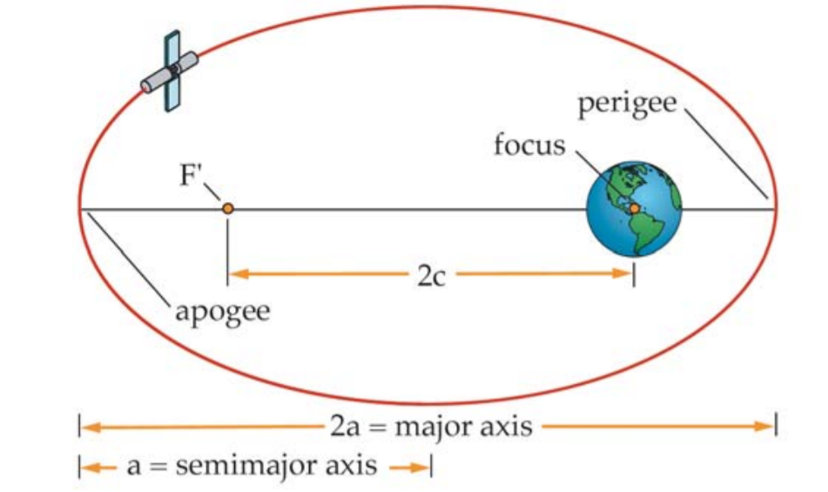
Ellipses in “nature”
Orbits of planets and moons
Left: Portrait of Kepler by an unknown artist, 1610, Right: Describing Orbits, Federal Aviation Administration: Advanced Aerospace Medicine On-line, Section III, space operations (Fig 4.1.4-2).

Slide 14
Ellipses in “nature”
Theatre design with acoustic effects:
Trier, (150CE),
arena, amphi-theatre
Adapted from source: Livius.org, © Jona Lendering, Livius.org, Licenced under CC0 1.0 Universal

Slide 15
Mathematics of ellipses
Geometry:
focus points,
constant sum of distance
Algebra:
standard equation
parametric equation

Slide 16
To be continued at the lightboard

Slide 17
Two examples in Processing
Generate-and-test
Thread art design

Slide 18
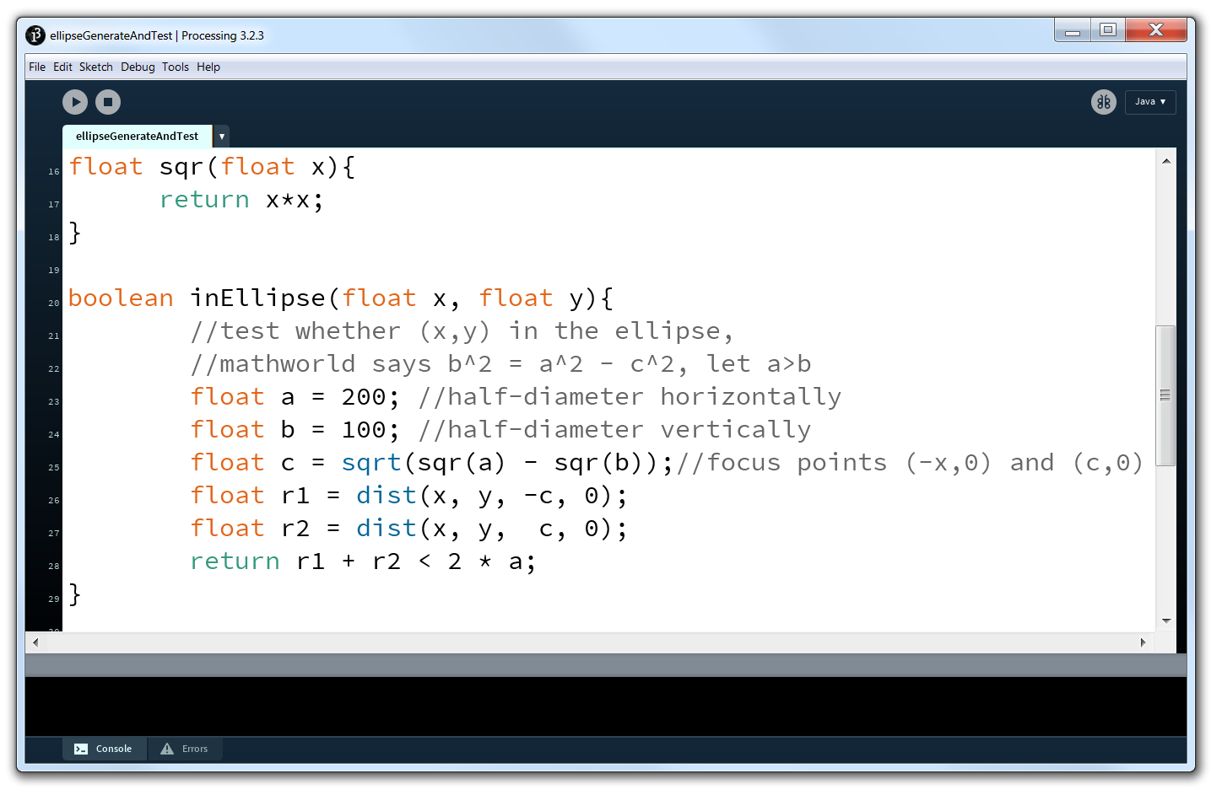

Slide 19
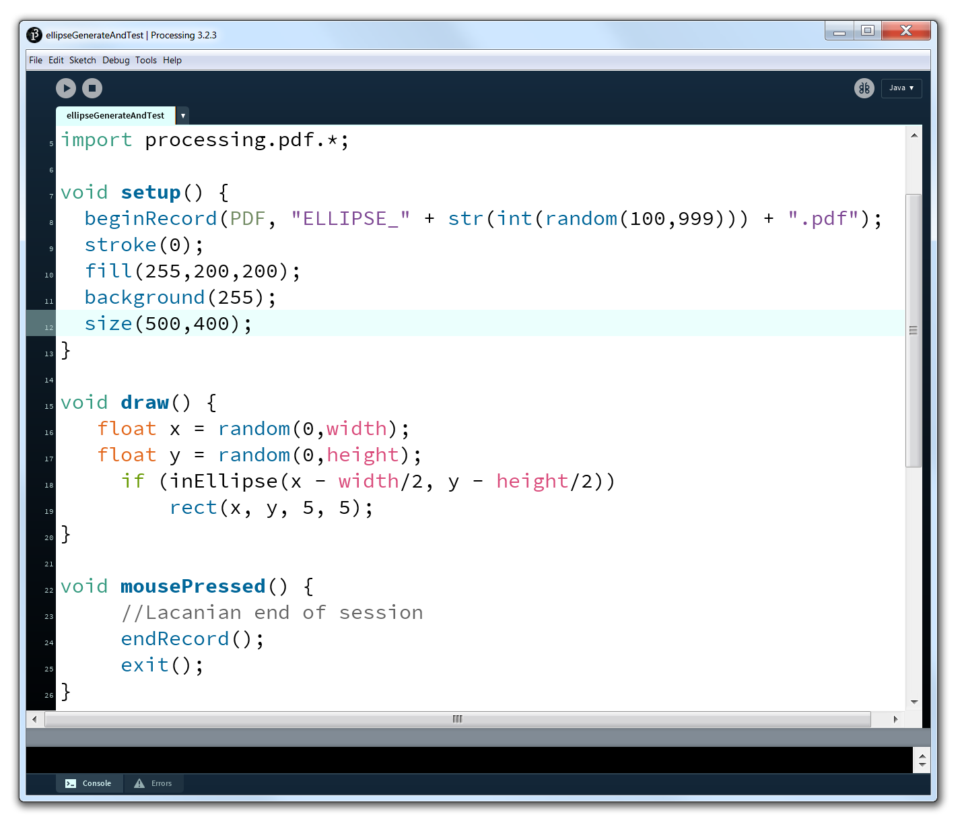

File: Lacan2.jpg, Wikimedia

Slide 20


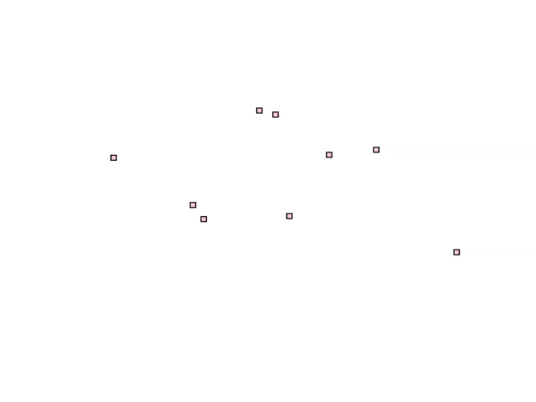


Slide 21
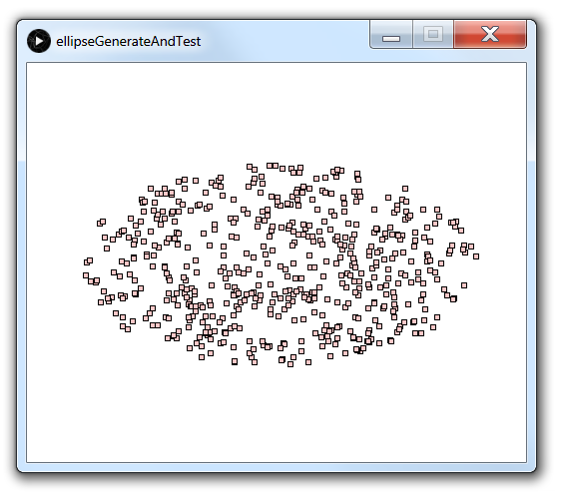

Slide 22
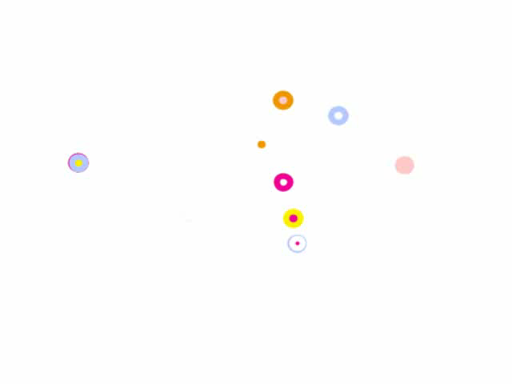

Slide 23
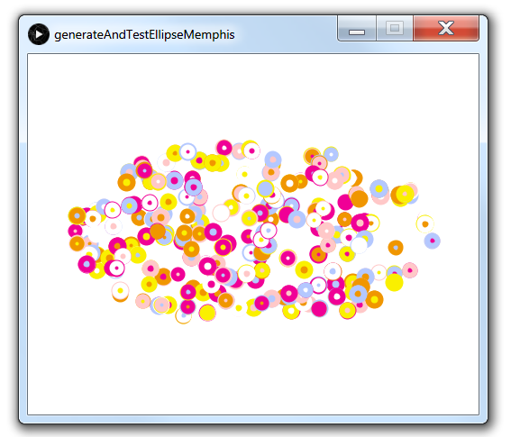

Slide 24
Second example
Thread art design:
N = 50 pins around ellipse
Then connecting pins:
J = 13 jump distance
connect pin i to pin i + J
Best:
lcm(N,J) = N×J

Slide 25
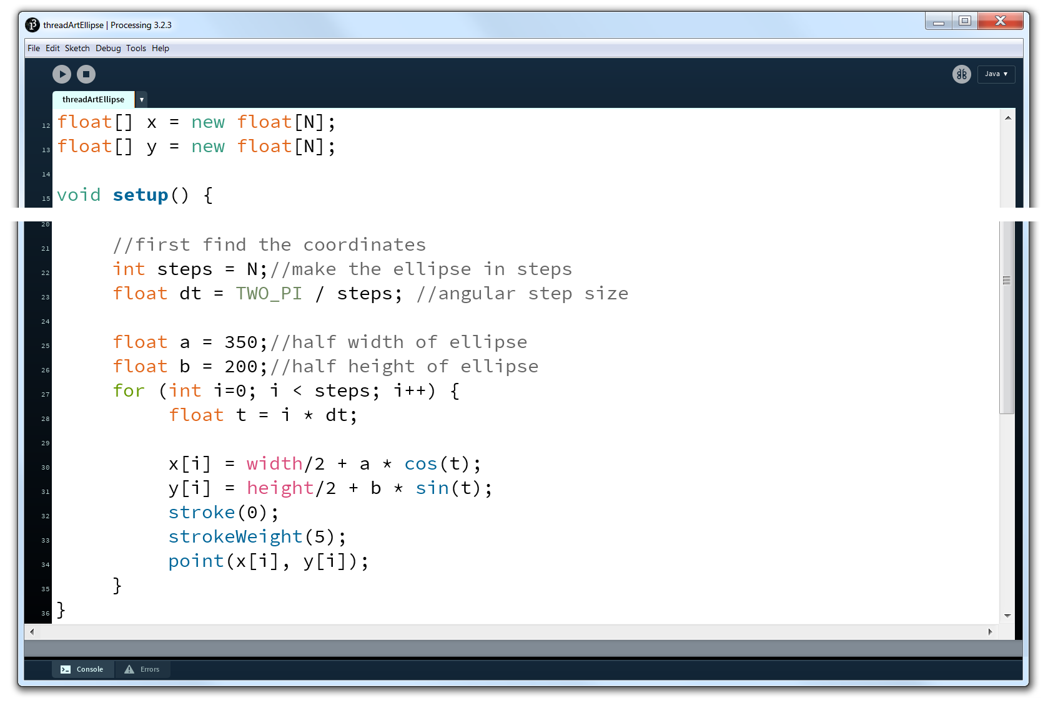

Slide 26
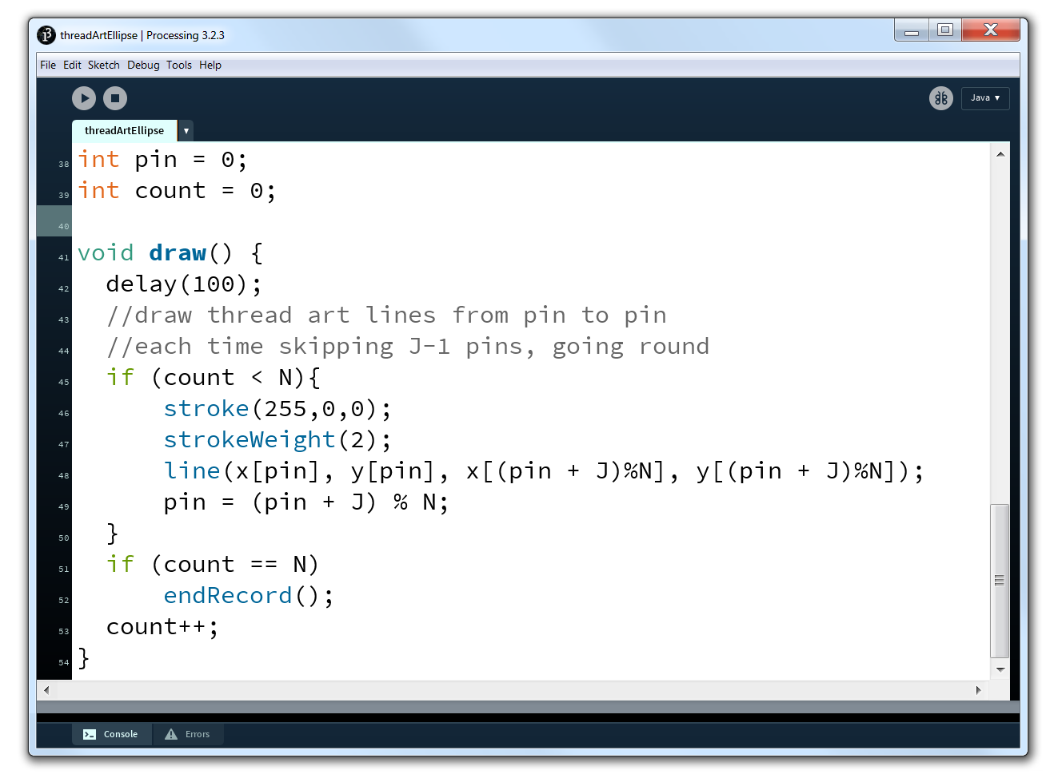

Slide 27
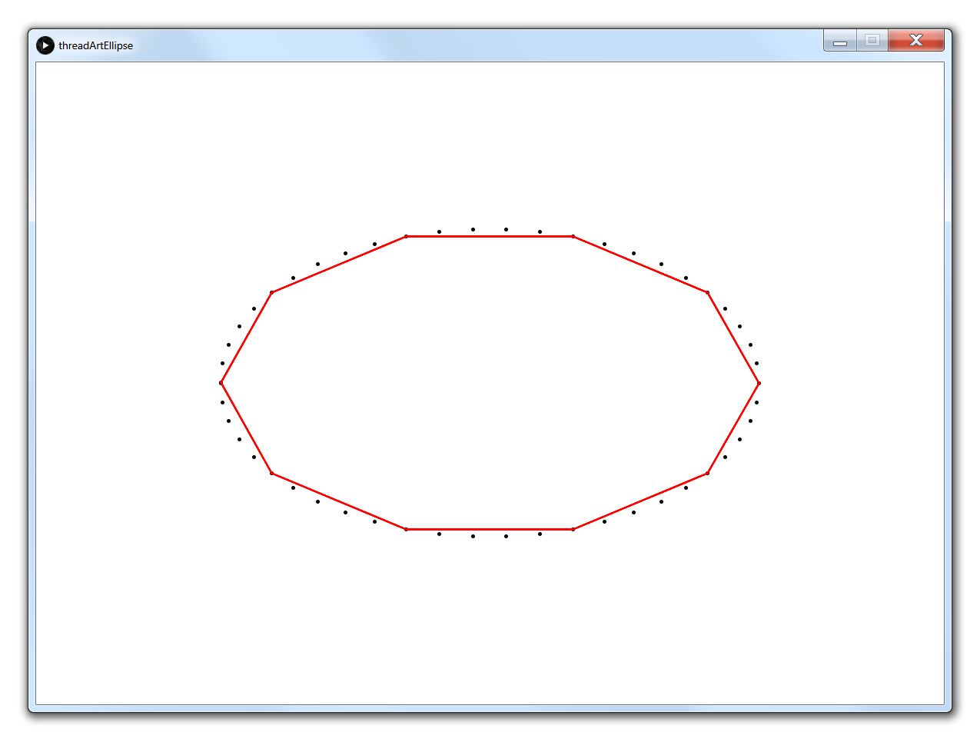
N = 50 J = 5

Slide 28
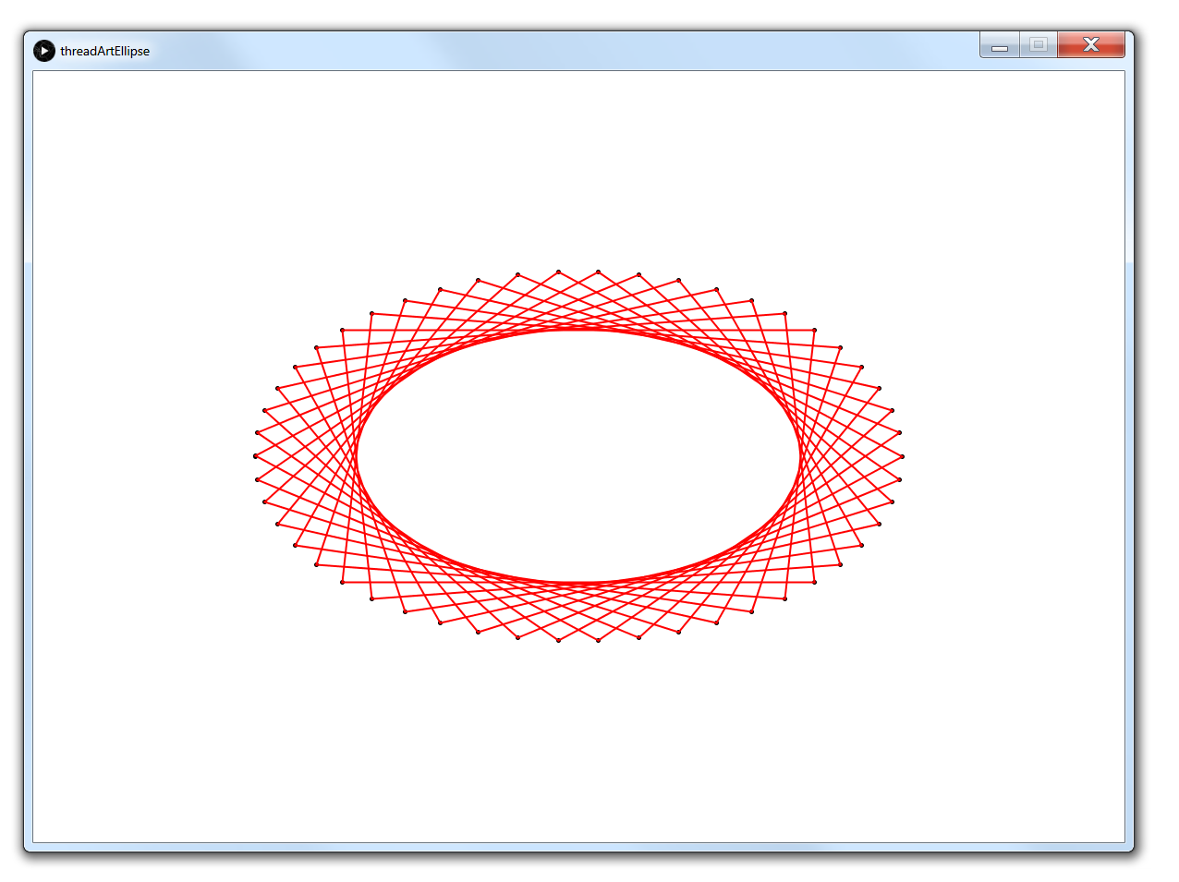
N = 50 J = 13

Slide 29
Recap and reflection
ellipses is just one example of “conic section”
make parabola, hyperbola, Lissajous in the same way
for generative design, find the parametric equation
programming principles:
generate-and-test
end like a Lacan session
pre-compute coordinates
jump around by modulo arithmetic
save vector graphics in pdf format

